Slide 1
Introduction à Design Assistant
3268.1 Vision Industrielle II
Yuri López de Meneses

Slide 2
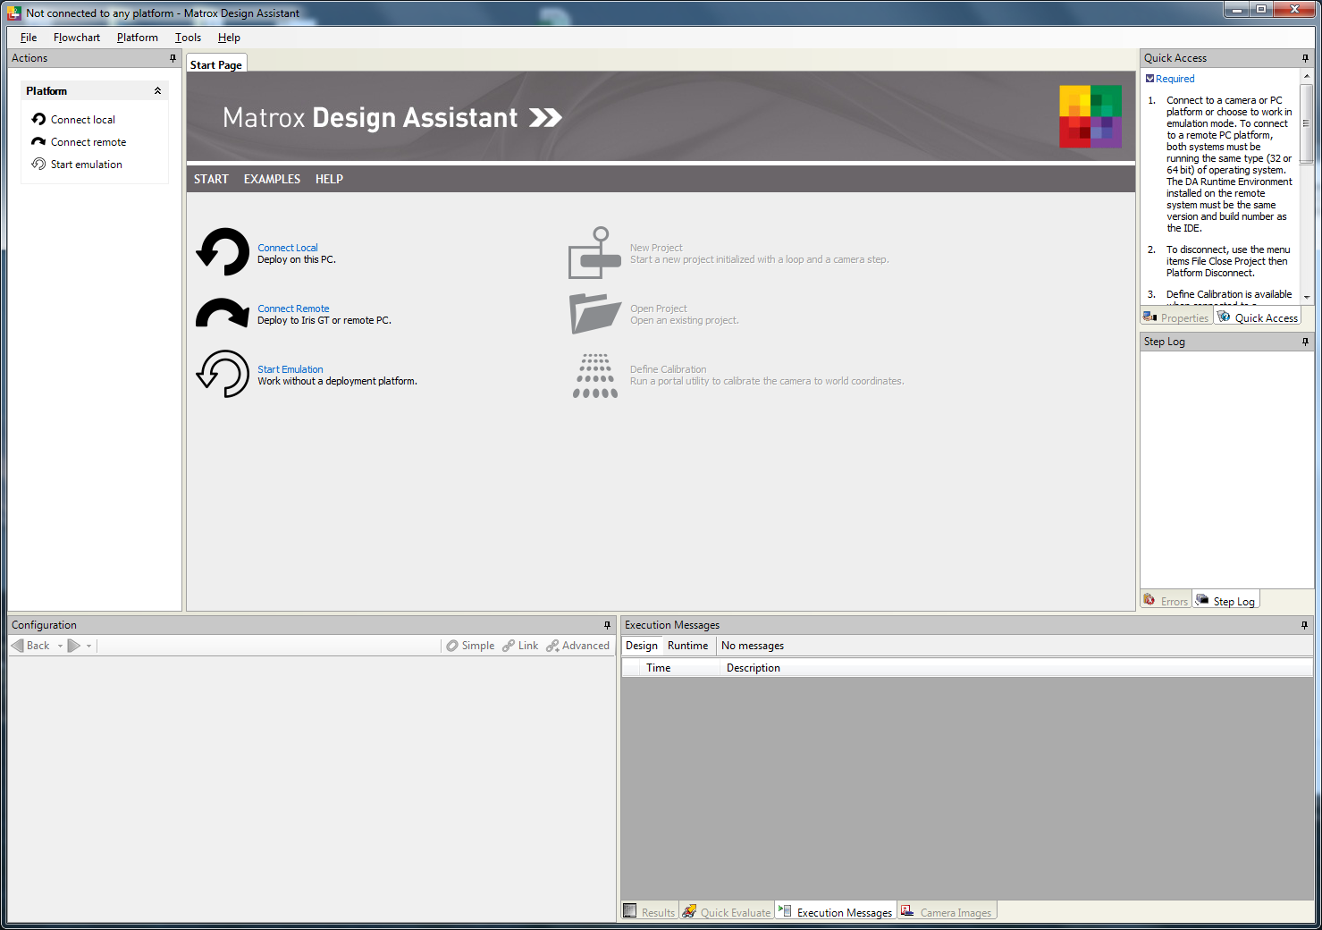
Démarrage
Lancer script StopDALicense admin.cmd
Connect local

Slide 3
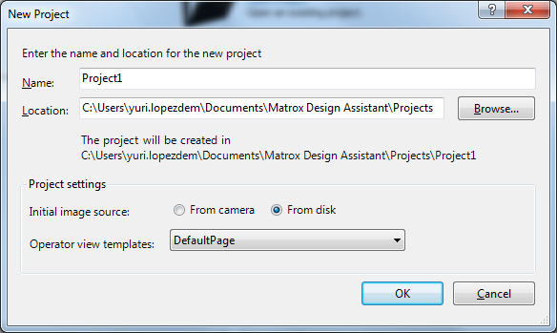
Démarrage
New Project

Slide 4
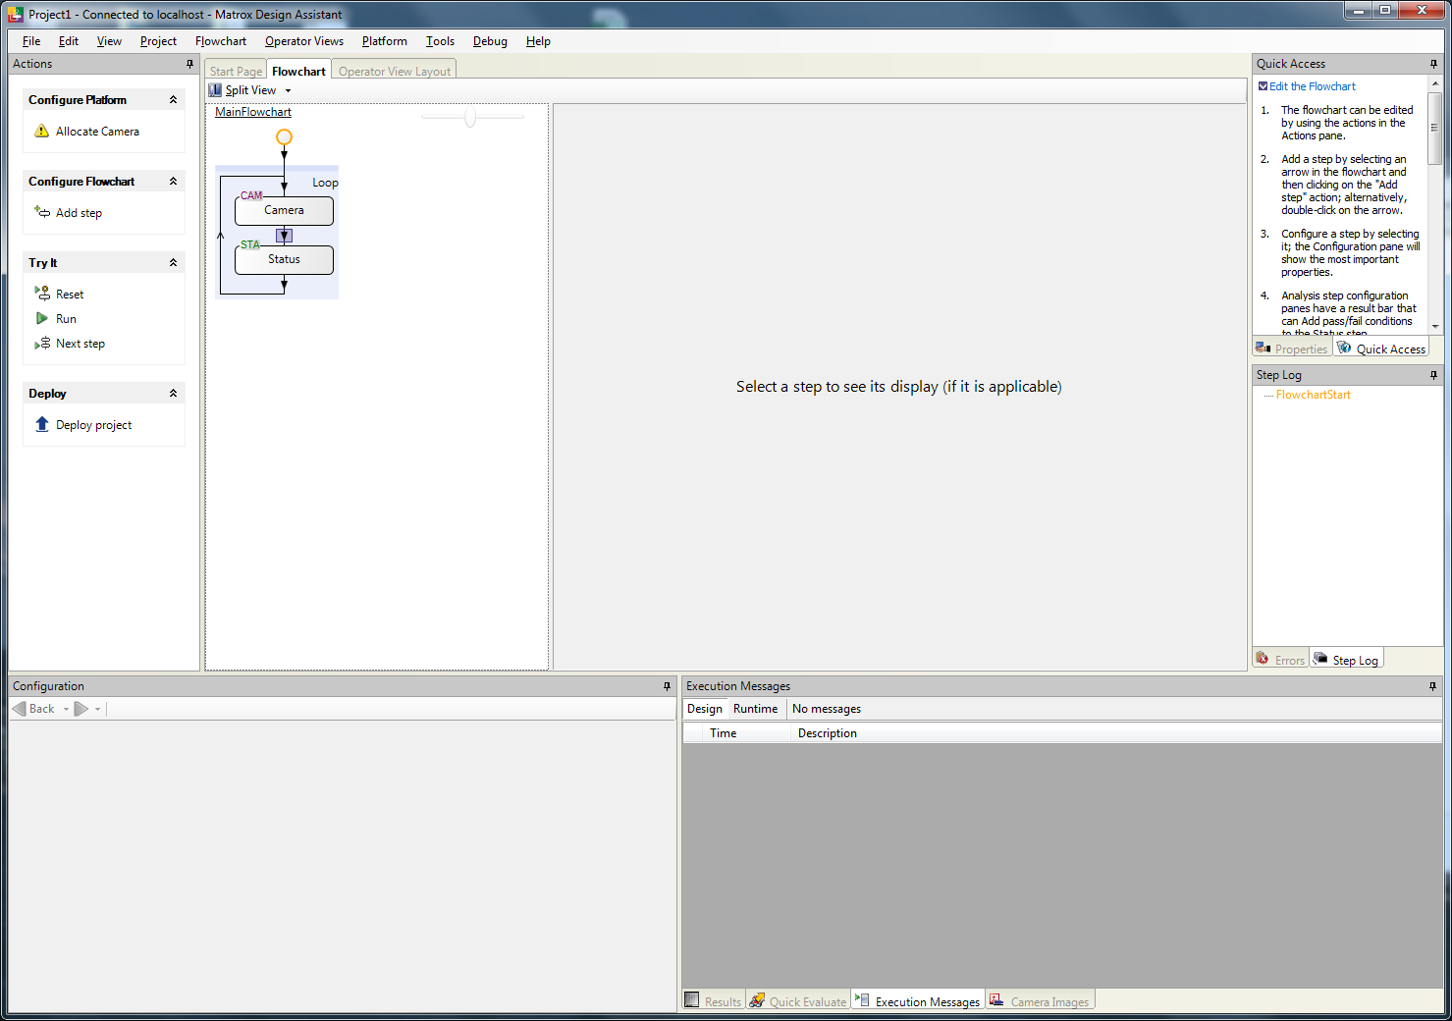
Démarrage

Slide 5
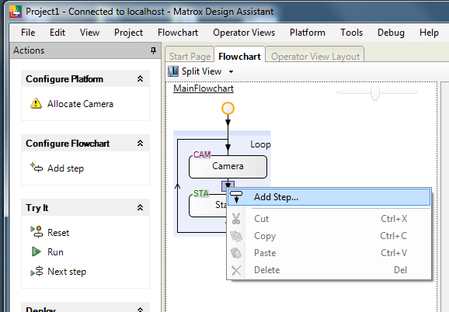
Flowchart
Add Step:
Right-Click on transition

Slide 6
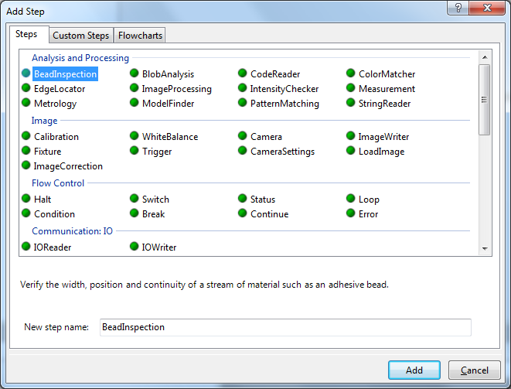
Flowchart
Step types:
Standard:
Processing: Matrox MIL modules
Image: Acquisition, saving
Flow control: Branching, Status
Communications: IO/Serial/Network/Buses
Communications Robot: Specialized for controller
Utilities: Counters, Read/Write to file, Time, etc.

Slide 7
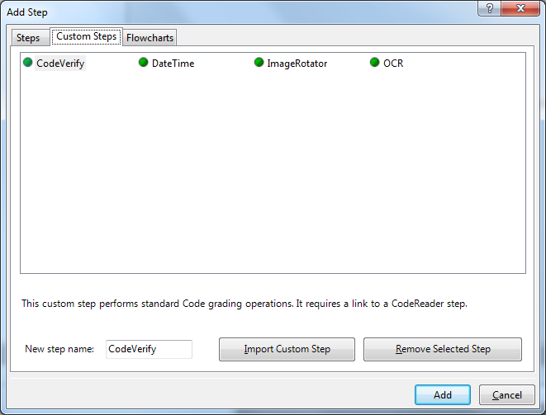
Flowchart
Custom Steps:
Added by user
Written in C#
Flowcharts:
Subflowcharts created by user

Slide 8
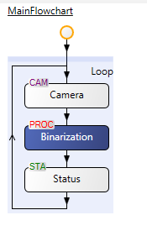
Flowchart
Flowchart
Step type («family»)
Step name
User defined

Slide 9
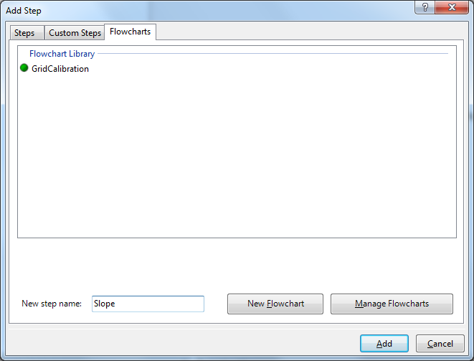
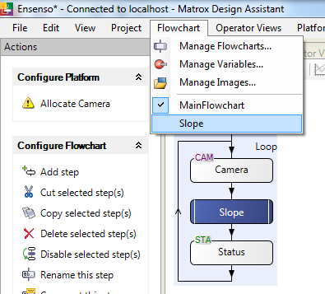
Subflowcharts
Similar to functions
Added as «steps»

Slide 10
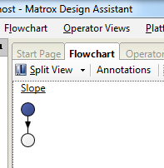
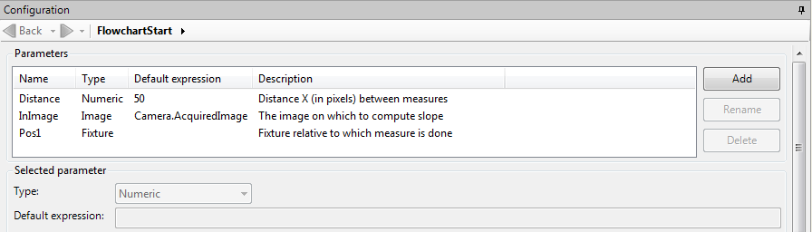
Subflowcharts
Like a function: Define inputs, outputs, flow
Inputs:
Select input «ball»
Define input variables

Slide 11
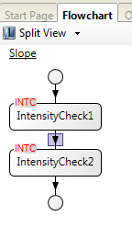
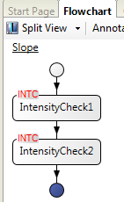
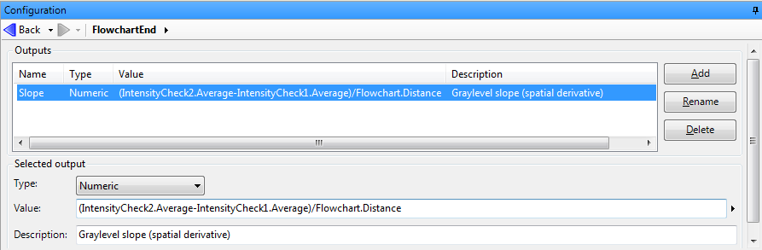
Subflowchart
Insert steps and configure them
Define outputs

Slide 12
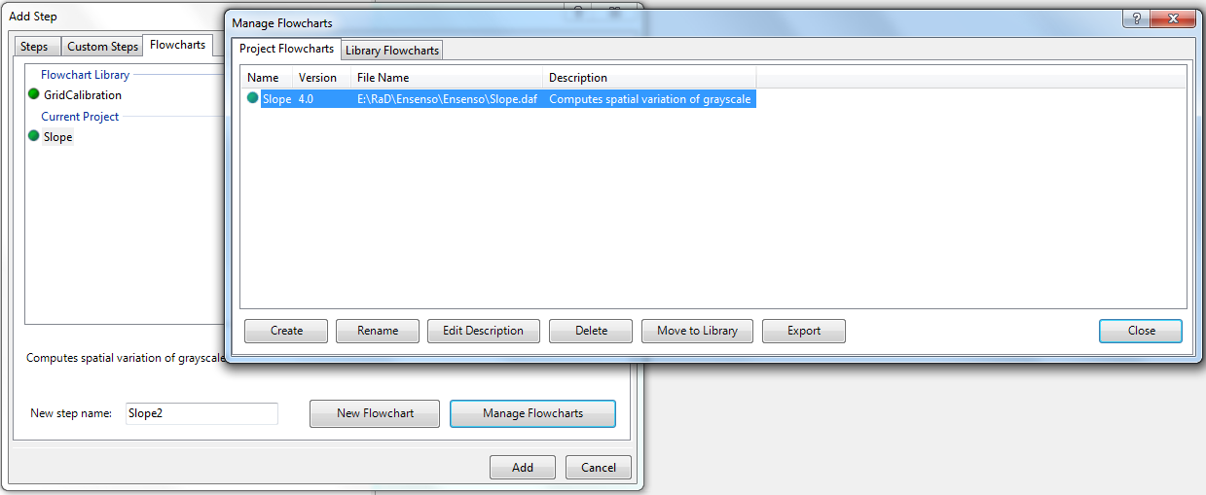
Subflowchart
Can be further inserted in main flowchart
Can be moved to library (for other projects)
Can be exported/imported (other platforms)

Slide 13
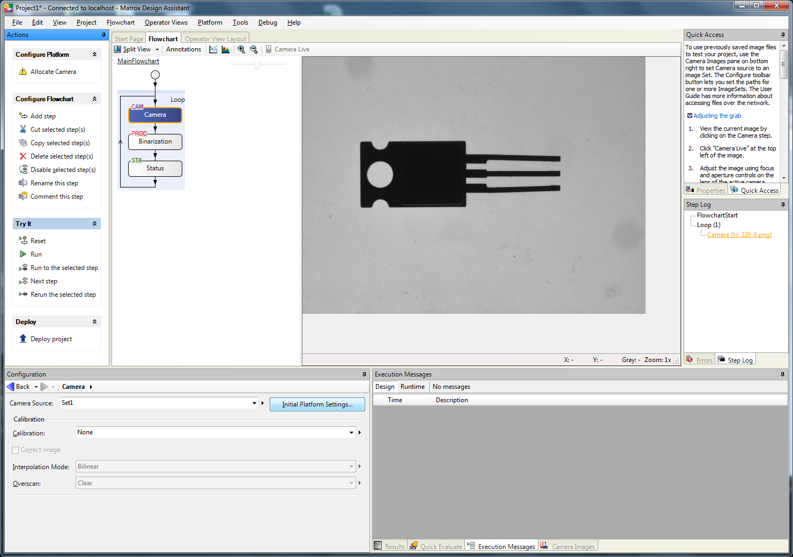
Flowchart
Actions
Step in
flowchart
Step image
Step Log
Step status
Step parameters

Slide 14
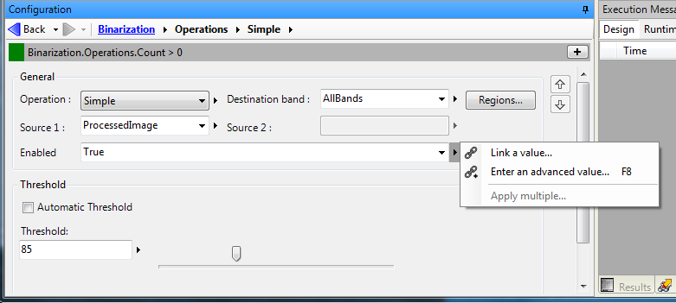
Flowchart
Step parameters
Values
Link to variables (all global!)

Slide 15
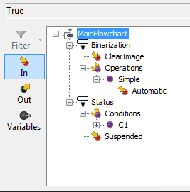
Flowchart
Variables (in TreeView)
Typed
Inputs / Outputs / Variables

Slide 16
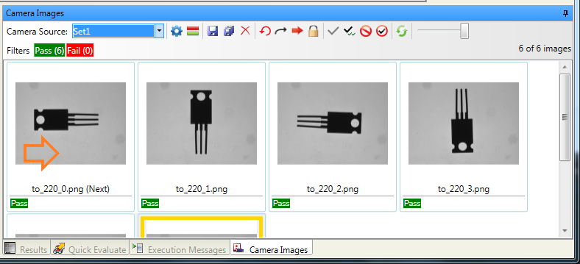
Flowchart
Step Status = Camera images

Slide 17
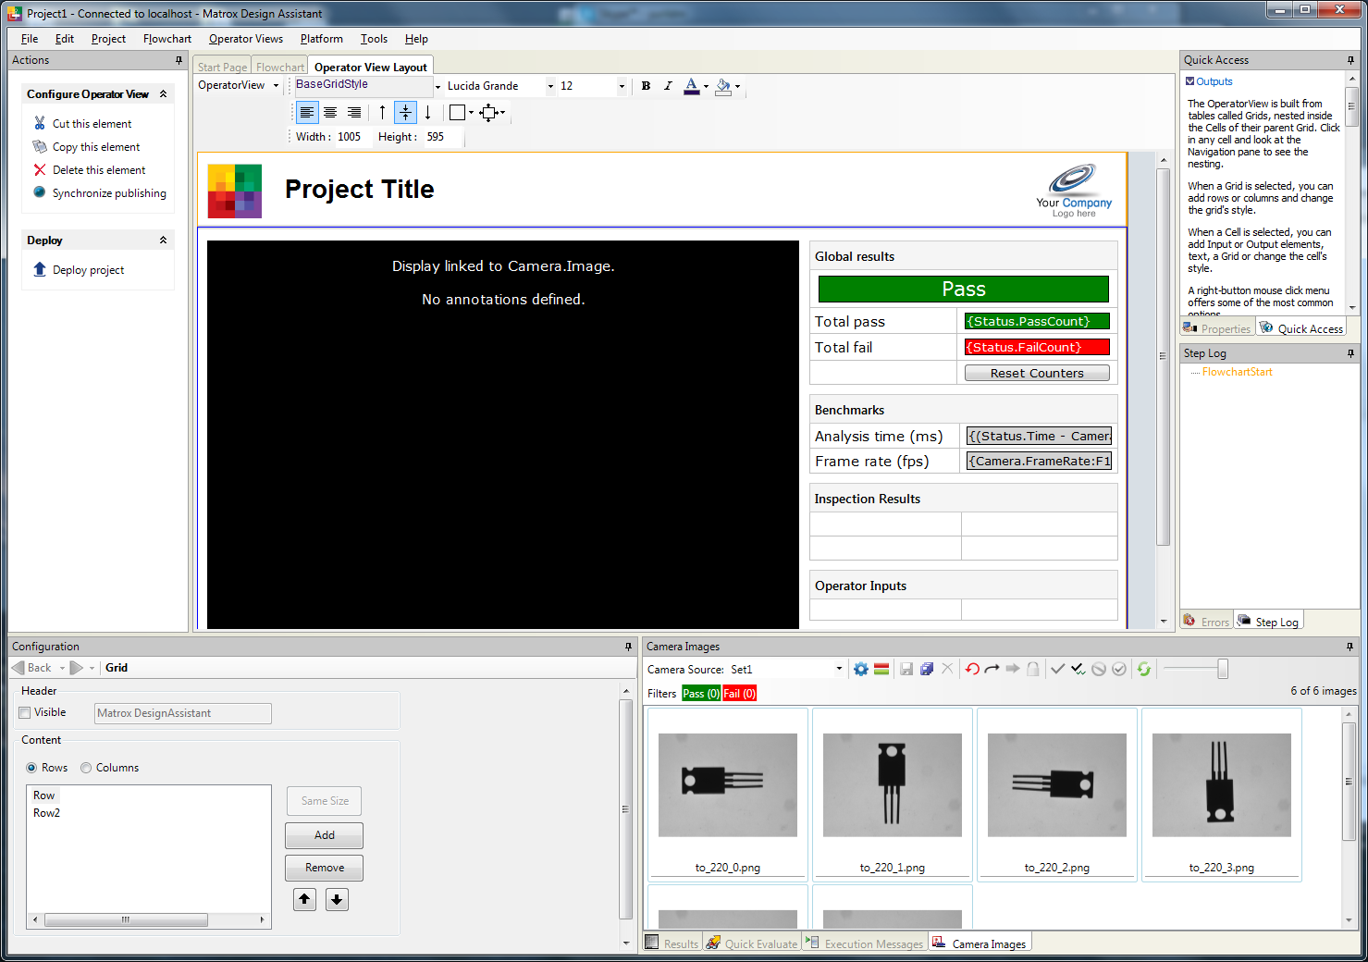
Operator View
In HTML5
Grid based
(table)
Preview
View parameters

Slide 18
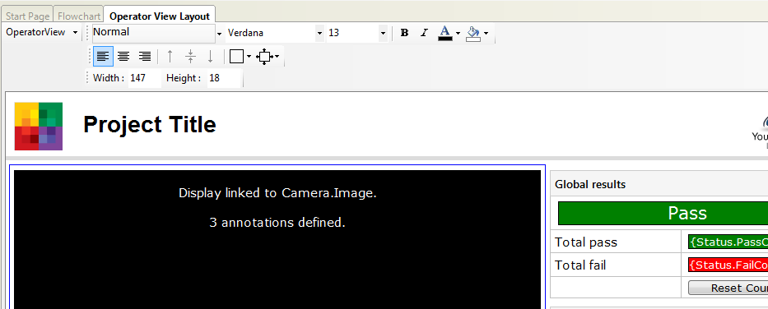
Operator View configuration
Operator View Layout

Slide 19
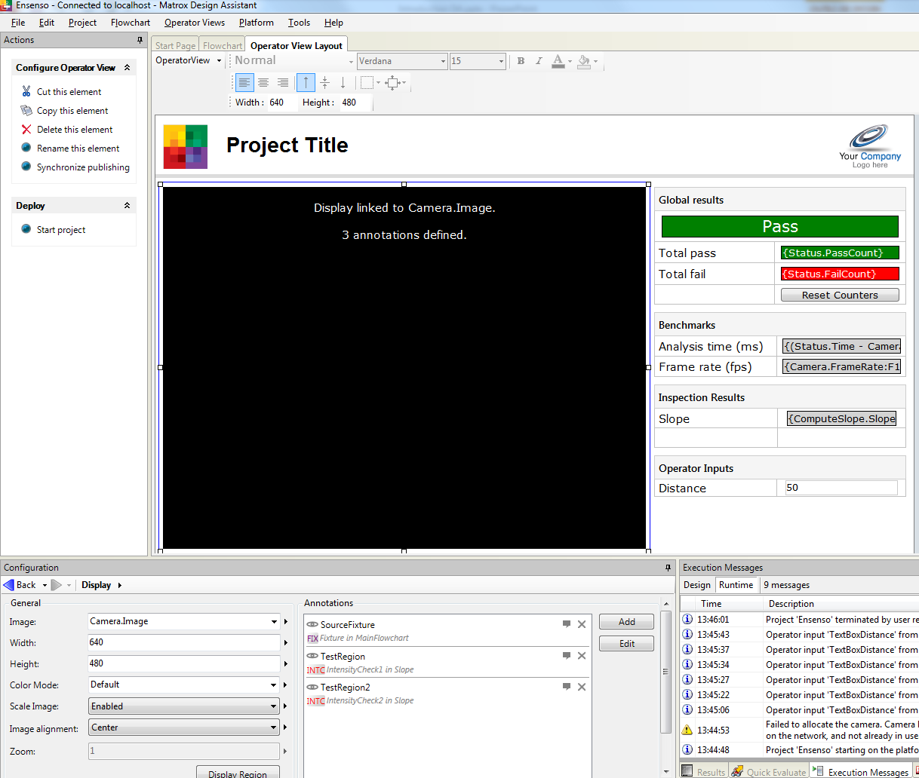
Operator View configuration
Display image to be associated to an image

Slide 20
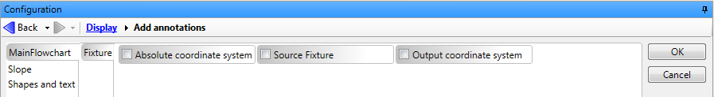
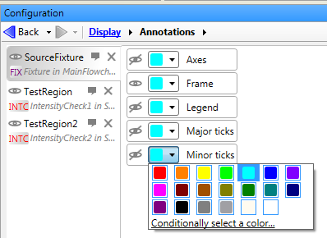
Operator View configuration
Annotations (overlays) to be defined
Select from each step
Define colors of each overlay element

Slide 21
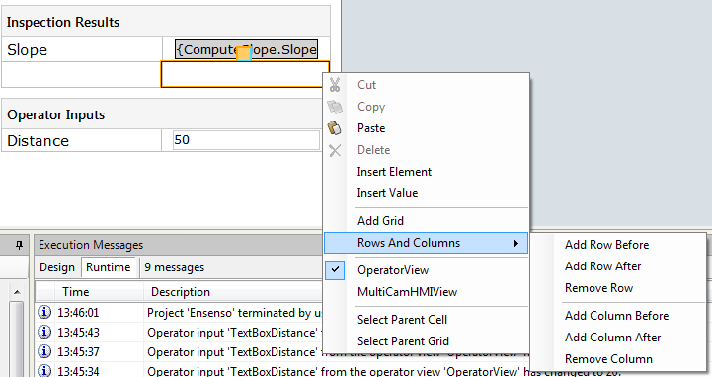
Operator View configuration
Inputs/Outputs arranged in grid
Insert rows and columns

Slide 22
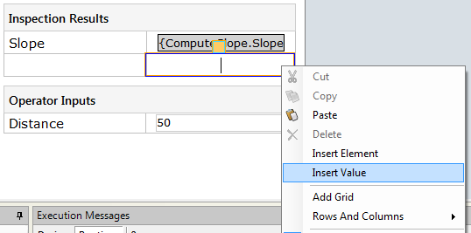
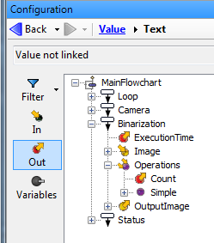
Operator View configuration
Outputs: Right click + Insert Value
Associate to variables, step inputs, step outputs

Slide 23
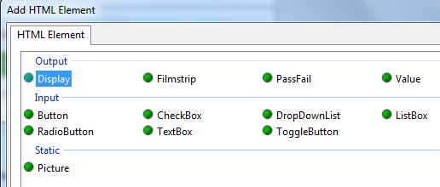
Operator View configuration
Inputs: Right click + Insert Element
Button, Checkbox, TextBox
Can be associated to variables, step inputs, step outputs

Slide 24
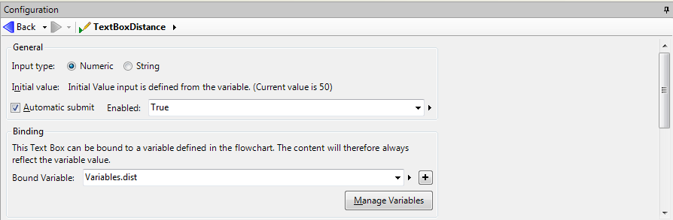
Operator View configuration
Inputs
Can be bound to variable
Input type, Initial value
Optionally set to Flow

Slide 25
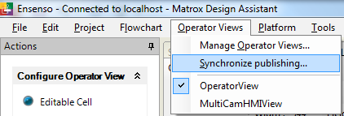
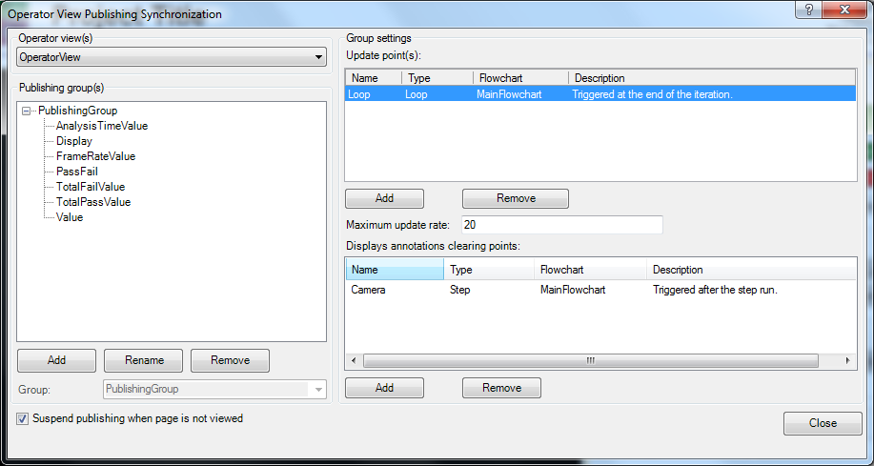
Operator View Configuration
Define synchronization
Update points
Update rate
Clear Annotation

Slide 26
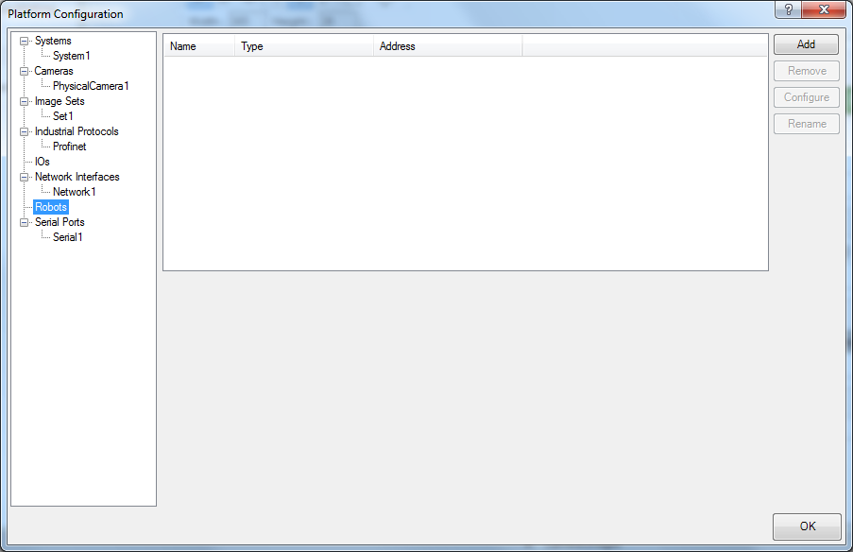
Platform configuration
Menu→ Project → Configure*
Cameras/Images from File
I/O, Serial, Network
Robot controllers

Slide 27
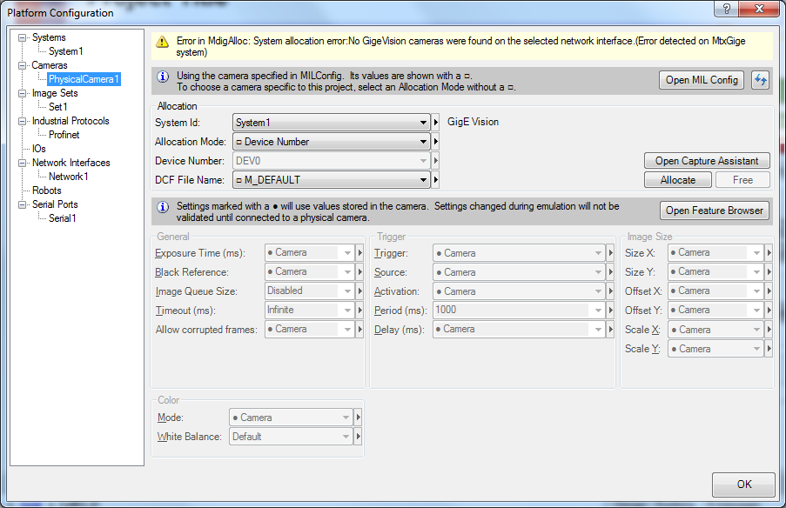
Platform configuration
Cameras
Select camera
Test in Capture Assistant
Allocate
Configure camera settings

Slide 28
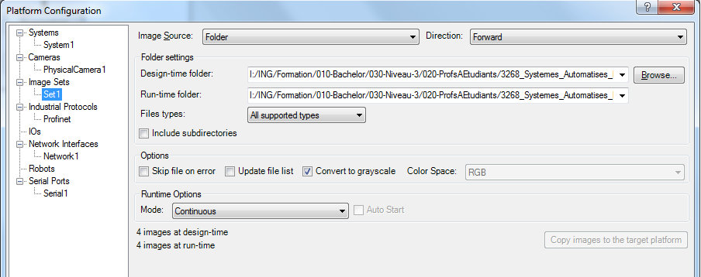
Platform configuration
Image sets
Multiple sets can be created
Path format with \\ or /

Slide 29
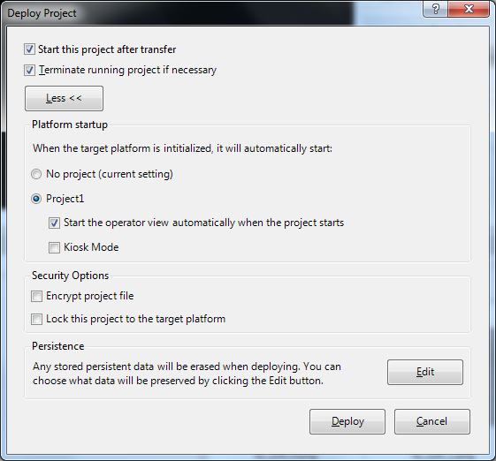
Running
Menu → Platform
Deploy Project : To a local or remote platform
Start Project

Slide 30
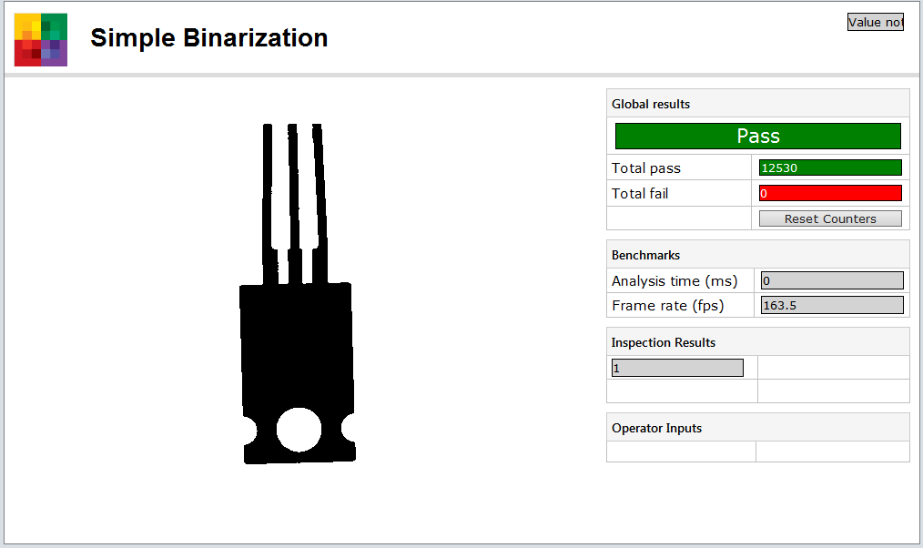
Running
Display in browser

Slide 31
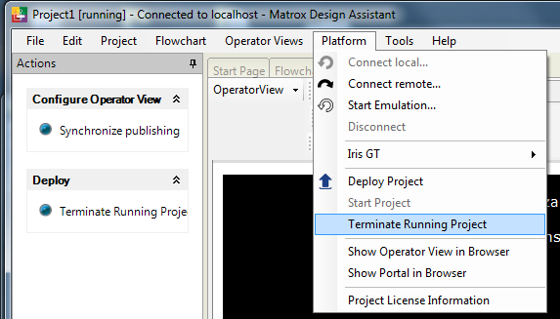
Stopping
Menu→ Platform → Terminate running project
or under Actions

